Slide 1
NDA workshop Vemurafenib (Zelboraf, Roche)
IND: 2006-09-01| NDA Submission: 2011-04-28 | NDA Approval: 2011-08-17
Sungpil Han
Dept. of Clinical Pharmacology & Therapeutics
Asan Medical Center
2018-03-02
Notes:
https://www.accessdata.fda.gov/drugsatfda_docs/nda/2011/202429s000TOC.cfm

Slide 2
Table of Contents
Introduction
Review: CMC
Review: Clinical Pharmacology
Review: Medical Review
Companion Diagnostics
Discussion

Slide 3
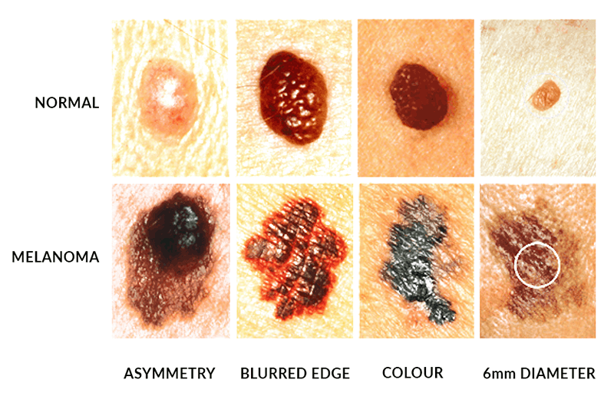
Introduction - Melanoma
Melanoma
5th leading cancer type in men
7th leading cancer type in women
estimated total of 76,100 new cases
9,700 deaths due to melanoma in 2014
Prognosis of metastatic melanoma
Median survival of approximately 6 months

Slide 4
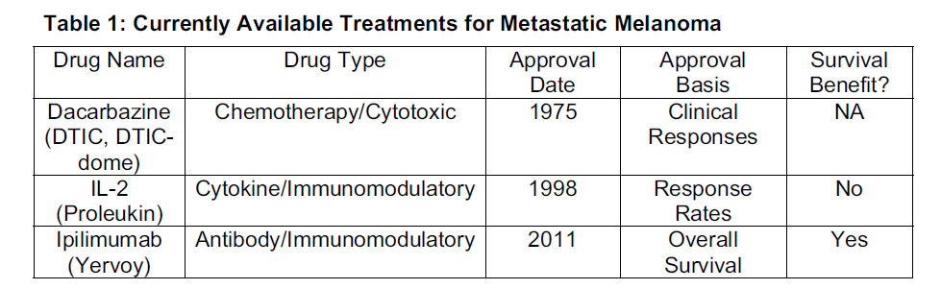
Introduction
3 drugs were approved by the FDA for the treatment of advanced melanoma.
Dacarbazine was approved over 30 years ago
no survival benefit has been demonstrated.
response rates with single-agent dacarbazine: 7% to 32%
OS: 5.6 to 11 months
Aldesleukin (IL-2) approval in 1998
A meta-analysis of chemoimmunotherapy versus chemotherapy found increased response rates and toxicity with chemoimmunotherapy
no improvement in survival

Slide 5
Introduction
Ipilimumab
monoclonal antibody targeting CTLA-4
approved in 2011
Median OS
ipilimumab–dacarbazine group : 11.2 months
dacarbazine group : 9.1 months
HR, 0.72 (95% CI, 0.59–0.87)

Slide 6
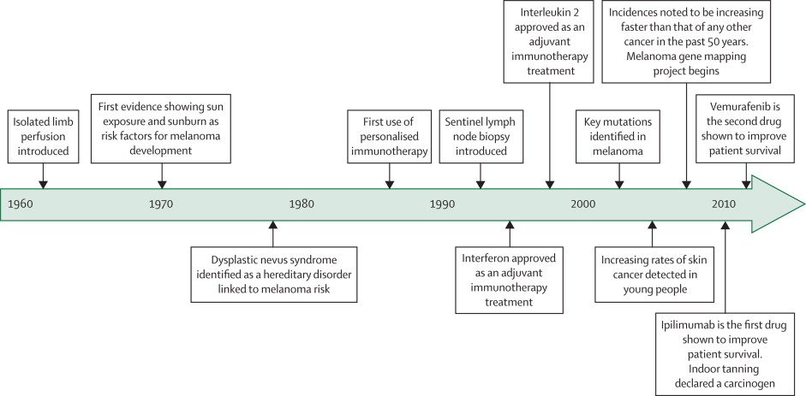
Timeline highlighting key events of the treatment of melanoma
Bombeli, Lancet, 2014
Notes:
Timeline highlighting key events since the 1960s that have directly affected the prevention and treatment of melanoma
Based on information made available from the American Society of Clinical Oncology.

Slide 7
Introduction
Somatic mutations in BRAF
increased activity of BRAF kinase
ERK activation and aberrant and uncontrolled cell proliferation and survival
In a prospective series of 308 patients with metastatic melanoma,
46% had a BRAF mutation
73% were V600E, 19% were V600K, and 6% were other.

Slide 8
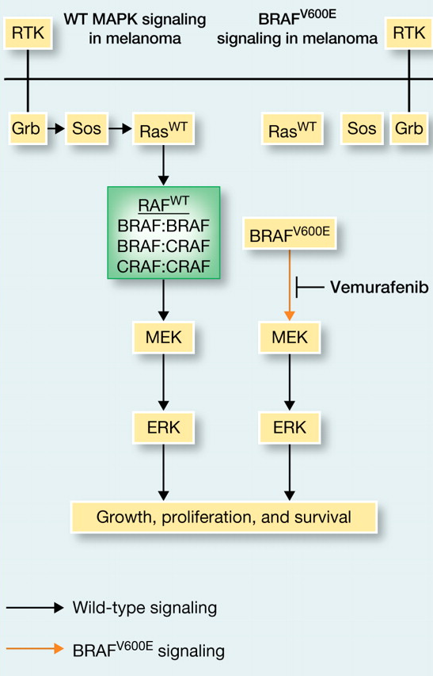
Introduction
Vemurafenib
Synthesized in 2005
BRAF_{V600E}: Selective binding to active form
Vemurafenib vs MEK inhibitor
Both: inhibition of cell proliferation
MEK inhibitor: inhibition of ERK phosphorylation in all cellular genotypes
Vemurafenib: ERK-phosphorylation only in BRAF-mutant cells
RAF inhibitor paradox
Paradoxical ERK phosphorylation induced by vemurafenib in WT BRAF cell

Slide 9
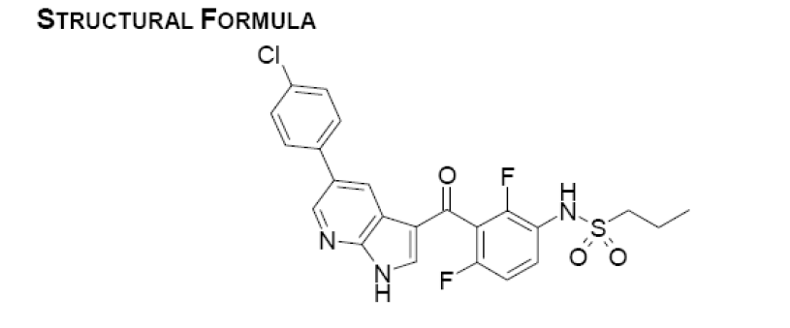
Introduction
PLX4032 or Vemurafenib (V600E mutant Raf inhibitor)
Initially developed by Plexicon and later Genentech
Zelboraf (vemurafenib) Tablet, 240 mg
for the treatment of unresectable or metastatic melanoma with the BRAFV600 mutation as detected by an FDA approved test

Slide 10
Introduction – Development Overview
Works well in vitro and in lab animals
Clinical trails begun 2008
Enrolled only patients with BRAF_{V600E}
Phase I: 16 patients with stage IV cancers
Median survival increased 9 → 15 months
Phase II: 132 patients with stage IV cancers
53% of patients responded. Similar increase in survival
Phase III: 675 patients with stage III or IV cancers
compared vemurafenib to dacarbazine
Stopped early. Dacarbazine patients moved to vemurafenib
FDA approval August 2011

Slide 11
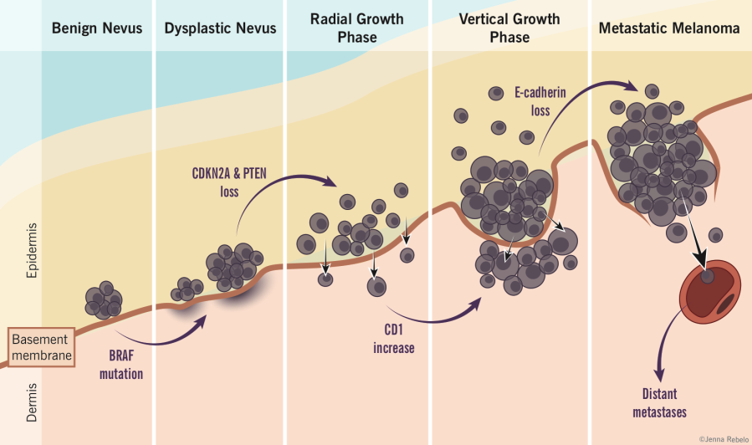
Introduction - Melanoma
Relapse rates
relatively high for late-stage disease
89% for stage IIIC
68% for stage IIIB
37% for stage IIIA
Stage IV has median survival of 9 months from diagnosis

Slide 12
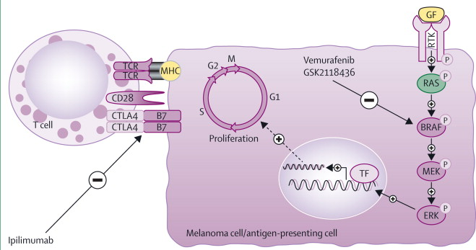
Mechanism of Action
Bombeli, Lancet, 2014
Notes:
http://www.thelancet.com/journals/lanonc/article/PIIS1470-2045(13)70333-4/fulltext
Figure 1
Present strategies to manage advanced stage melanomas include inhibition of the mutant form of BRAF kinase (a common mutation being BRAFV600E ; vemurafenib and GSK2118436) and T-cell activation (ipilimumab)
TCR=T-cell receptor. GF=growth factor. MHC=major histocompatibility complex. RTK=receptor tyrosine kinase. CTLA4=cytotoxic T lymphocyte antigen 4. TF=transcription factor.
View Large Image | View Hi-Res Image | Download PowerPoint Slide

Slide 13
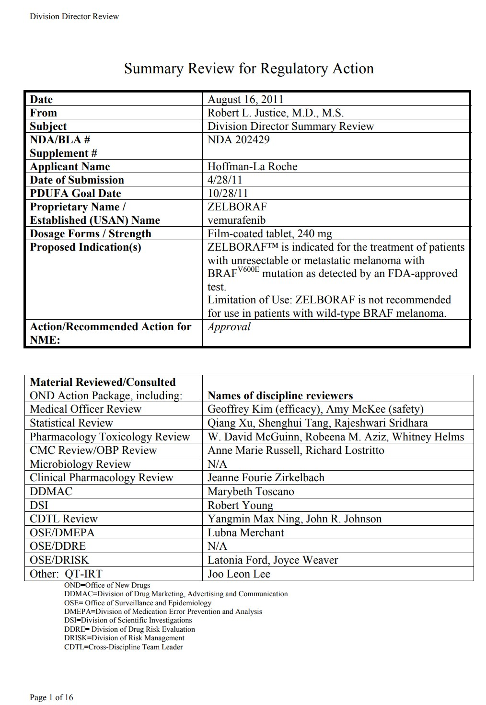
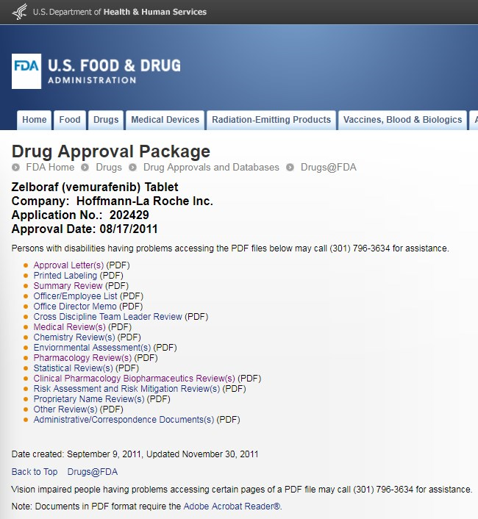
1st page of summary review (16 pages)

Slide 14
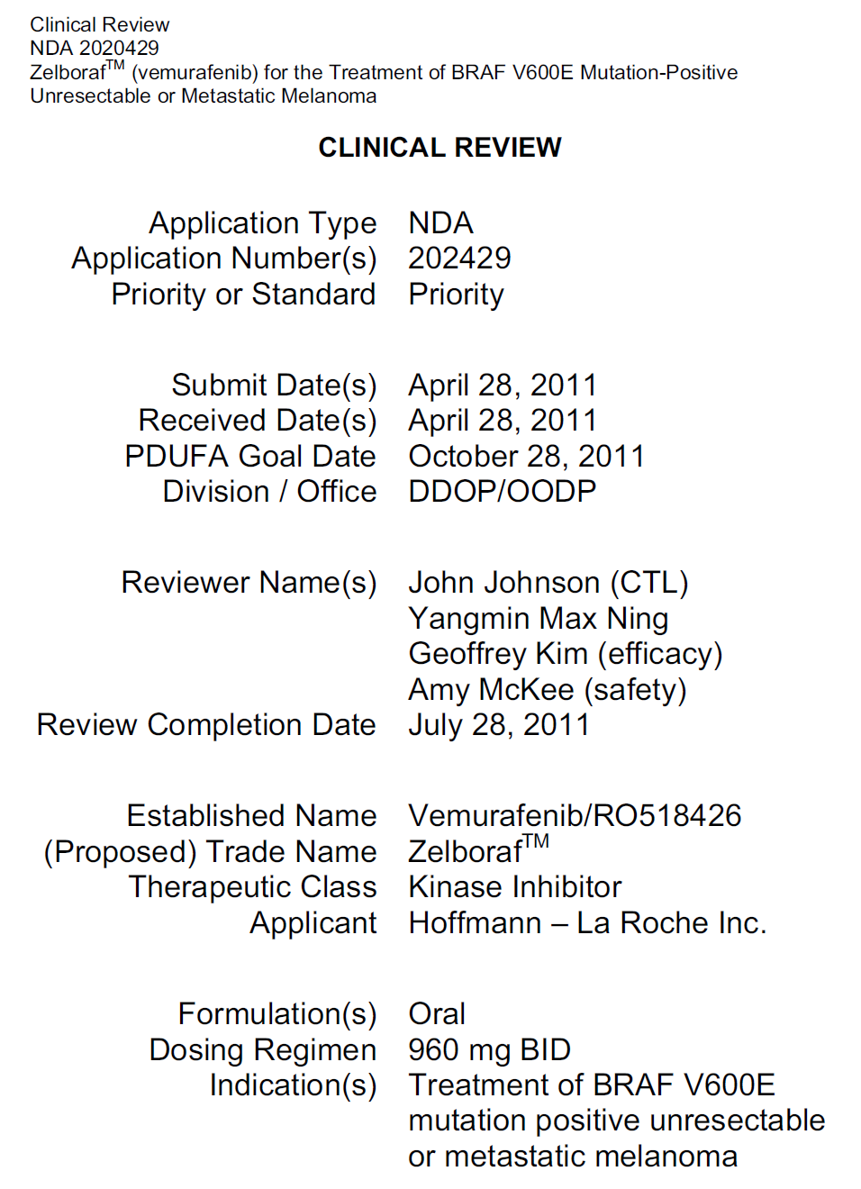
1st page of medical review (97 pages)
Priority review: 6 months (Standard review: 10 months)
Division of Drug Oncology Products/
Office of Oncology Drug Products
Clinical Review, NDA 2020429

Slide 15
Review: CMC (39 pages)
Chemistry, manufacturing, control

Slide 16
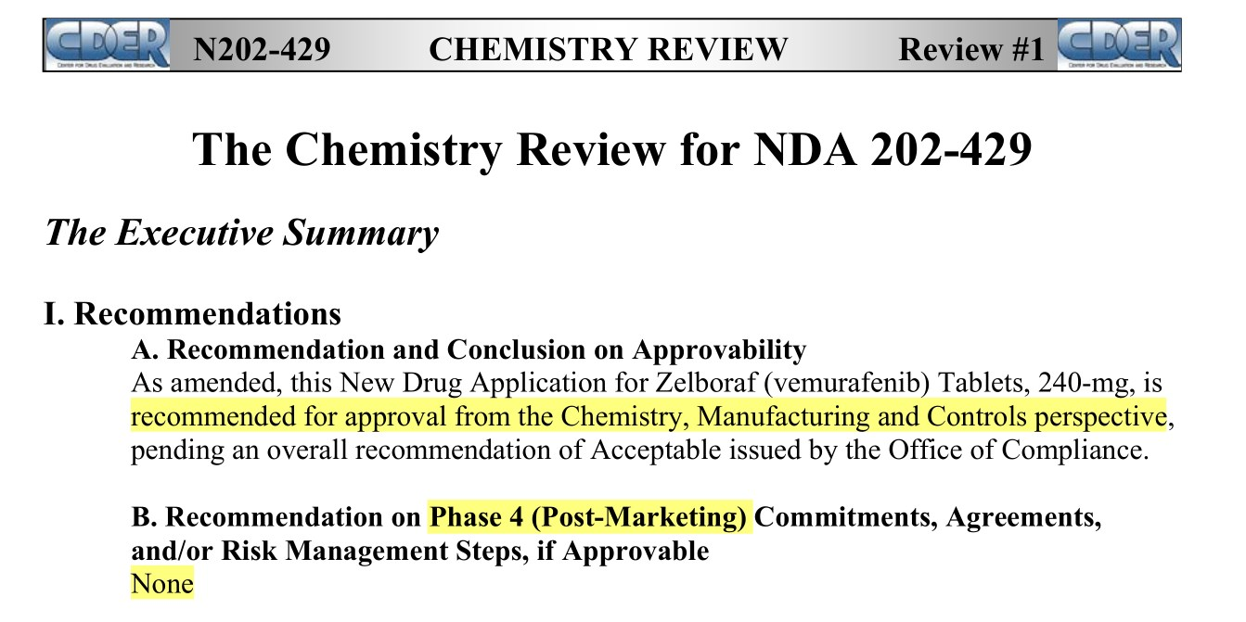
Chemistry

Slide 17
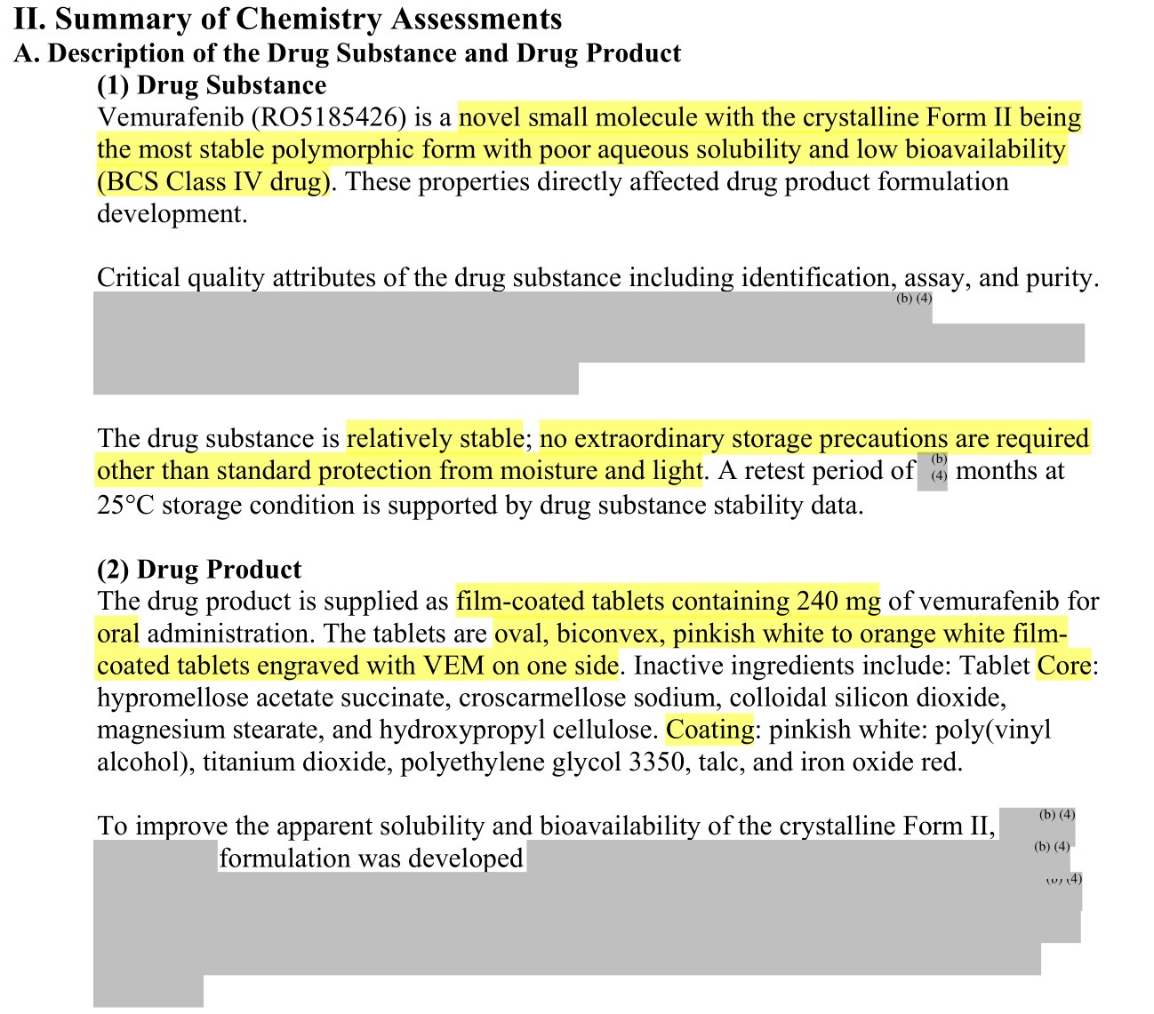

Slide 18
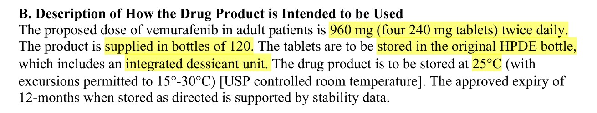

Slide 19
Review: Clinical Pharmacology (84 pages)
Chemistry, manufacturing, control

Slide 20
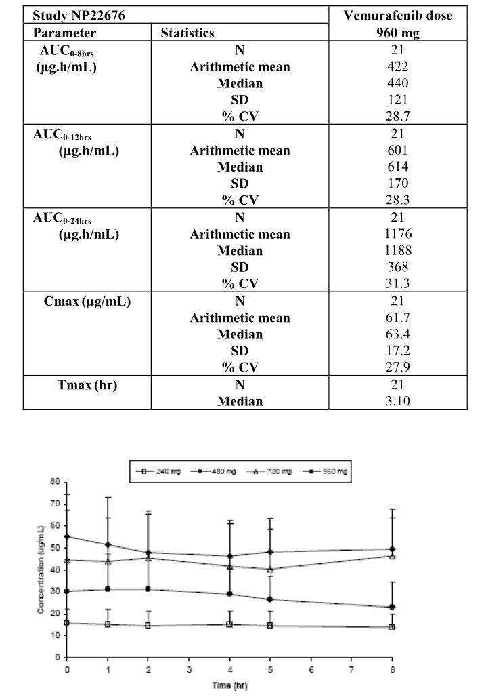
Clinical Pharmacology
Population PK
plasma concentration-time profile
one-compartment pharmacokinetic model
first-order absorption and first-order elimination.
PK at steady state
linear between 240 and 960 mg
Oral administration of 960 mg twice daily (for 15 days)
t_{max:} : ~ 3 hours
C_{max} :62 μg/mL ± 17
AUC0–12 : 601 ± 170 μg*h/mL.
FES: not been conducted
vemurafenib was administered without regard to food in the clinical trial.

Slide 21
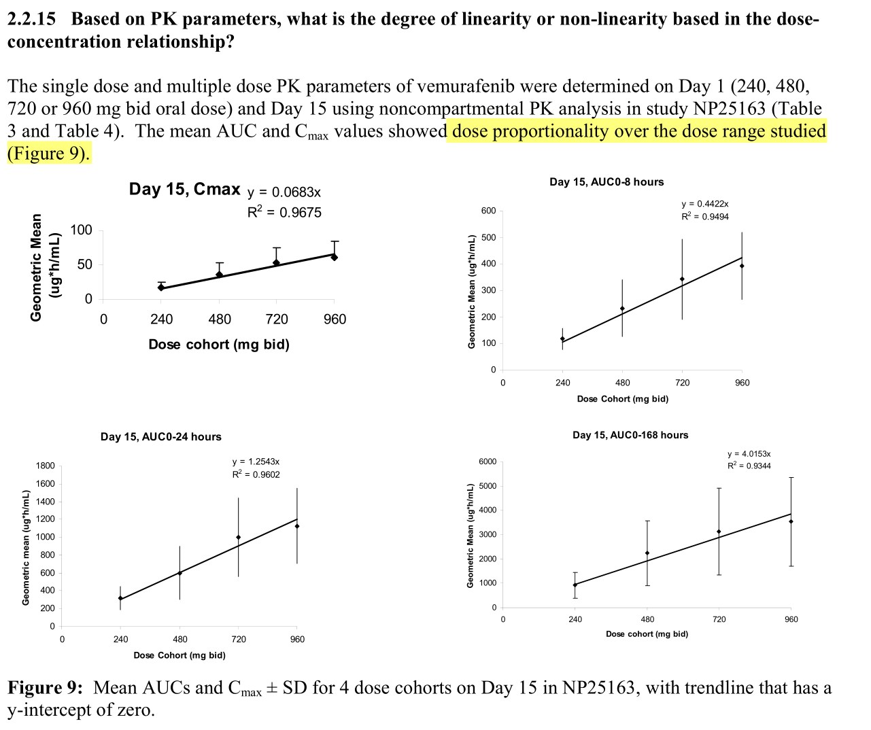

Slide 22
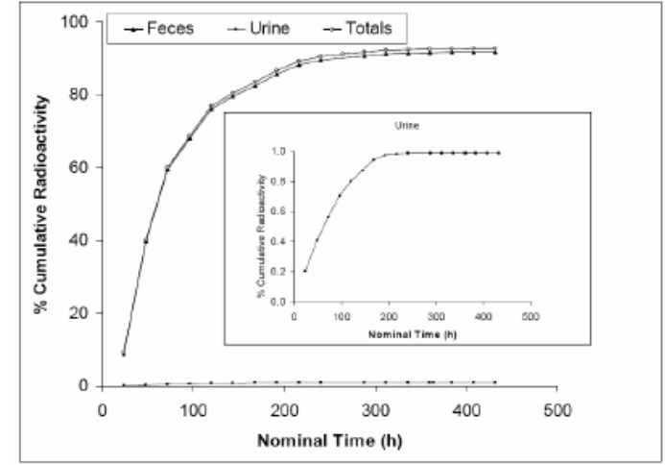
Clinical Pharmacology
Protein binding
highly bound (>99%) to human albumin and alpha-1 acid glycoprotein, and
Volume of distribution (V_{ss})
estimated to be 106 L.
Elimination
Excretion
mainly excreted in feces (94%)
Plasma clearance
31 L/day
Median elimination half-life
57 hours
¹⁴ C-vemurafenib

Slide 23
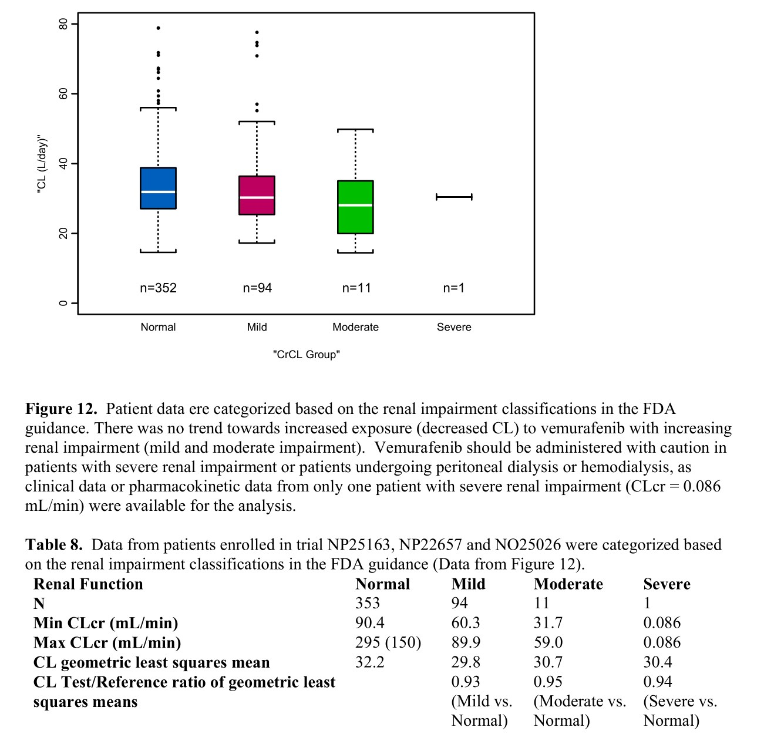

Slide 24
Clinical Pharmacology
Hepatic impairment
Vemurafenib clearance was similar in patients with normal, mild, and moderate hepatic impairment
“Therefore, dose adjustments are not needed for mild and moderate hepatic impairment.”
effect of severe hepatic impairment on vemurafenib exposure was unknown.
Drug Interaction
In vitro
substrate of CYP3A4 and
both a substrate and inhibitor of P-glycoprotein.

Slide 25
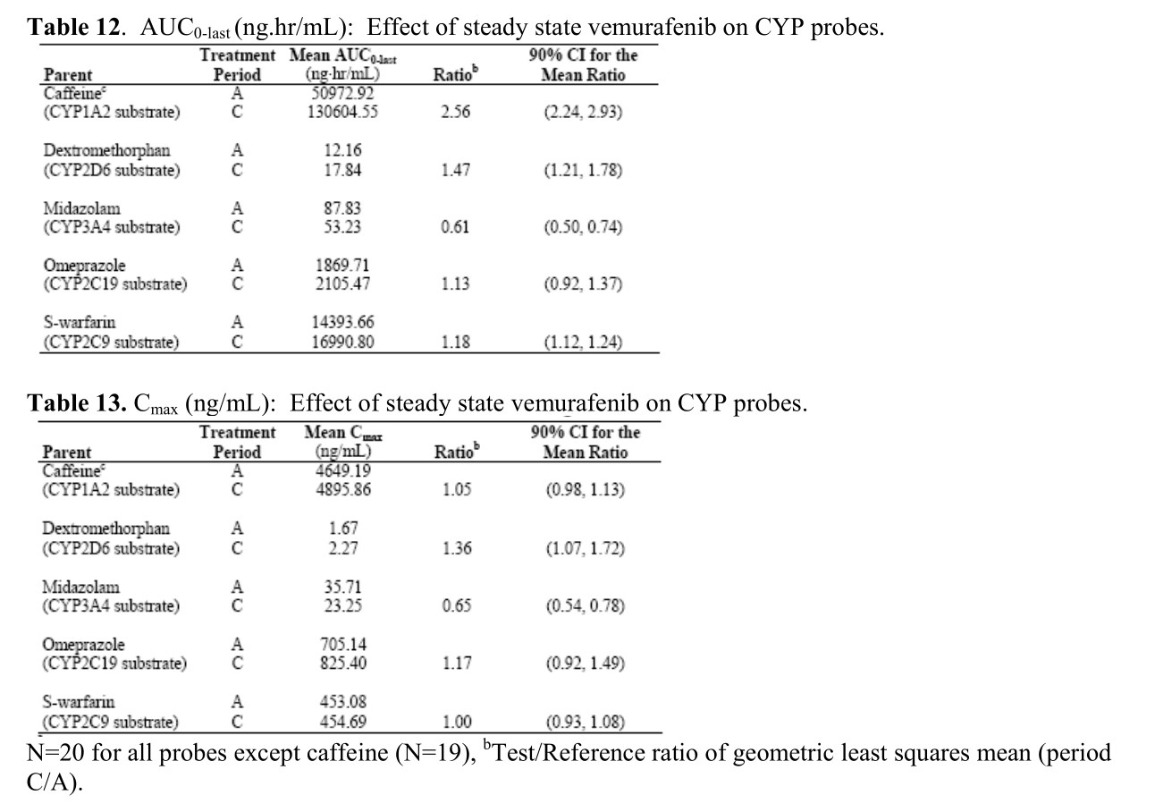
Effects on CYP enzyme
“cocktail approach” was used in trial NP22676 to investigate the potential drug-drug interactions
of vemurafenib with multiple CYP enzymes in patients with metastatic melanoma. The applicant used a combination of probe drugs known as the “Cooperstown 5+1 cocktail” in trial NP22676.
Clinical Pharmacology and Therapeutics. 2000 Oct;68(4):375-83.
In vivo
inducer of human CYP3A4
moderate inhibitor of CYP1A2
a weak inhibitor of CYP2D6

Slide 26
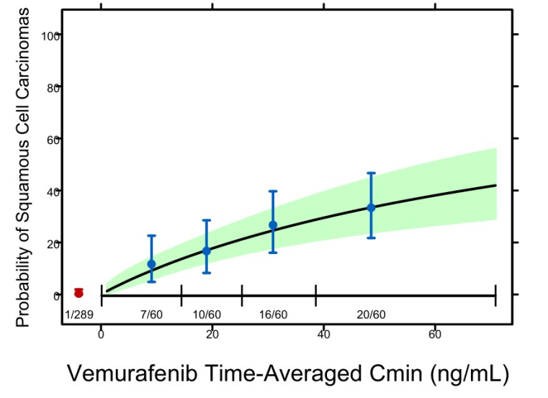
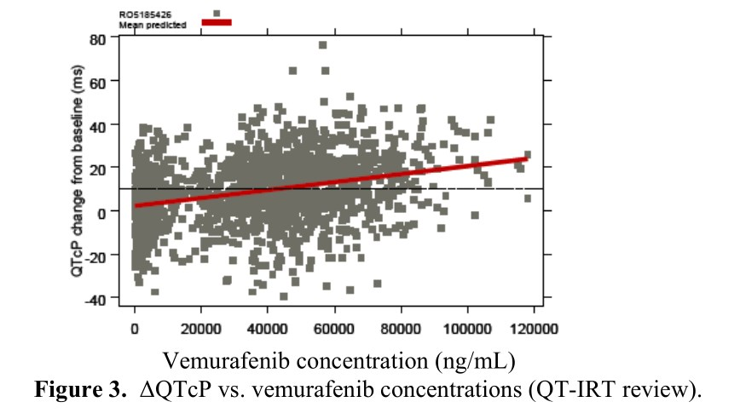
Clinical Pharmacology
significant exposure–response relationship
progression-free survival (PFS)
vemurafenib exposure (C_{min})
conclusive relationship between exposure and OS could not be demonstrated.
Significant exposure–response relationship
risk of cuSCC development and vemurafenib exposure (C_{min})
exposure–QTc response analysis
data from the phase II trial showed that following treatment with vemurafenib 960 mg twice daily
QTc interval was prolonged in a concentration-dependent manner
no large changes (i.e., >20 ms) in the mean QTc interval

Slide 27
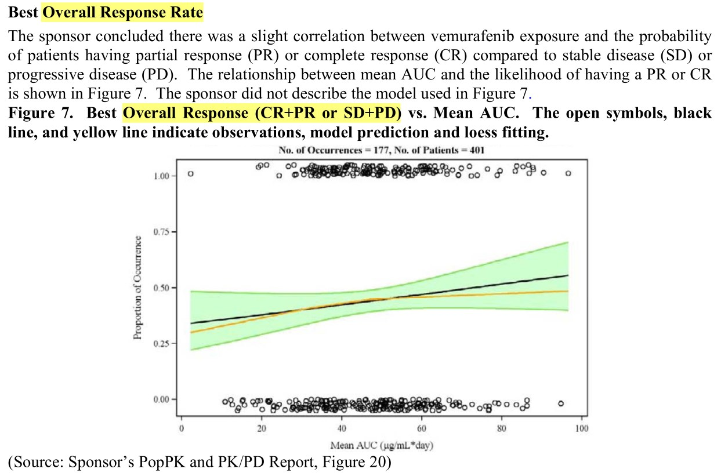

Slide 28
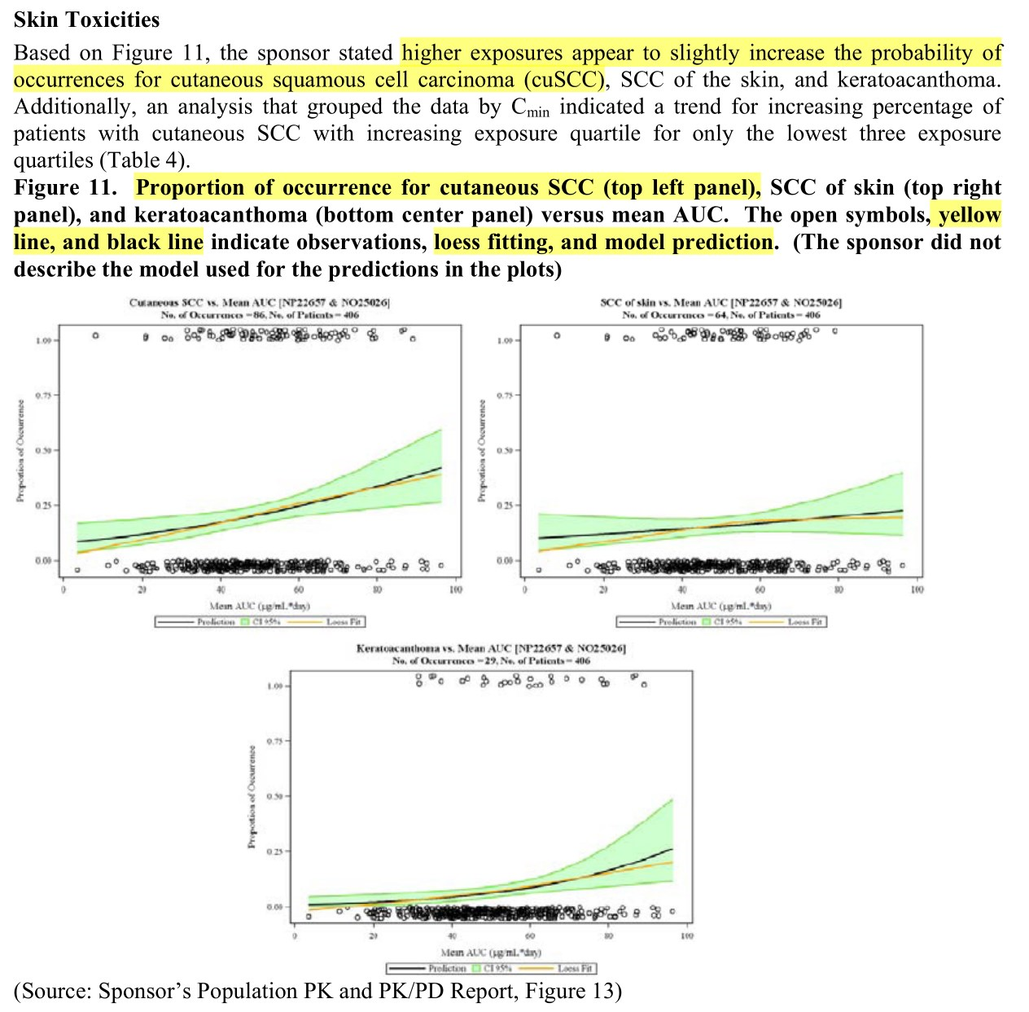

Slide 29
Review: Medical Review, Clinical Trials (105 pages)

Slide 30
IND (2006-09)
The IND named PLX4032
claimed as a selective inhibitor of BRAF kinase V600E mutant and intended to be investigated in patients with tumors containing the point mutation, including melanoma
The Phase 1 protocol was evaluated and found to be safe to proceed

Slide 31
Phase I Study (2007-2009)
Original formulation: poor bioavailability
Use of new formulations of PLX4032
Form of a microprecipitated bulk powder (MBP) drug polymer-matrix
to improve the bioavailability of PLX4032
Phase 1 study: New formulation could be started at 160 mg BID
The FDA evaluation of the safety data determined.
equivalent to the original formulation at 800 mg BID in terms of serum levels of the product.
determined MTD - 960 mg BID,
verified further in an expansion cohort of patients with metastatic melanoma positive for the BRAFV600E mutation.

Slide 32
End-of Phase 1 Meeting (2009-05)
Proposed to develop RO5185426 (PLX4032) in
patients with advanced melanoma with the
BRAF V600E mutation and to use a response rate of
?30% or PFS (HR 0.5 and an improvement of 2
months) as regulatory endpoints for accelerated
approval. The proposal was based on the
encouraging tumor response results from 16
patients with advanced melanoma positive for the
BRAF V600E mutation
? The Agency recommended the sponsor conduct a
randomized Phase 3 trial with overall survival as the
primary endpoint given that no evidence showed
that PFS is not an adequate surrogate endpoint in
metastatic melanoma.
? The Agency expressed its willingness to discuss
use of a single-arm study to support accelerated
approval “once the sponsor has more data
suggesting impressive activity”.
? The Agency also recommended the sponsor initiate
a comprehensive long term plan to monitor the
safety of the product, including possible incidences
of non-cutaneous squamous cell carcinomas
? The Agency also discussed issues on the
development of a companion diagnostic to detect
the BRAF V600E mutation during clinical trials

Slide 33
Fast Track Designation (2010-06)
The request for the Fast Track designation
granted
on the basis that the product was being investigated to improve overall survival in patients

Slide 34
Expanded Access Program
This application provides an example of the need
for sponsors and the FDA to communicate and respond
rapidly to important new information. With publica-
tion of the unprecedented results from the phase I trial,
followed shortly thereafter by preliminary confirmation
of activity of vemurafenib in the
phase II trial,
assumptions used to design the BRIM-3 trial were overly conservative.
The FDA and the sponsor worked together quickly to amend the rapidly accruing BRIM-3 trial and to open an expanded access program.

Slide 35
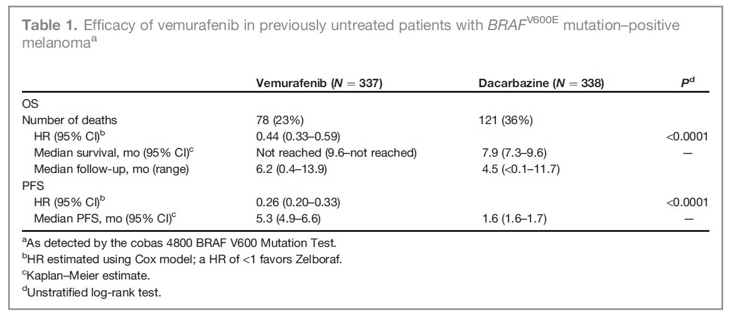
Efficacy of vemurafenib

Slide 36
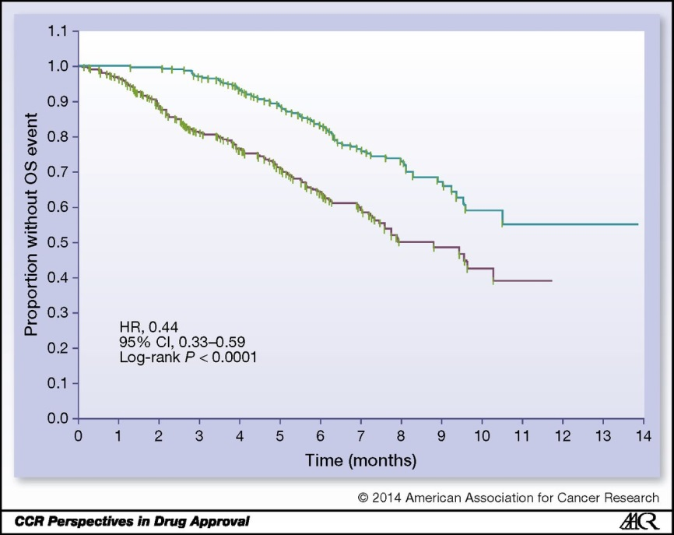
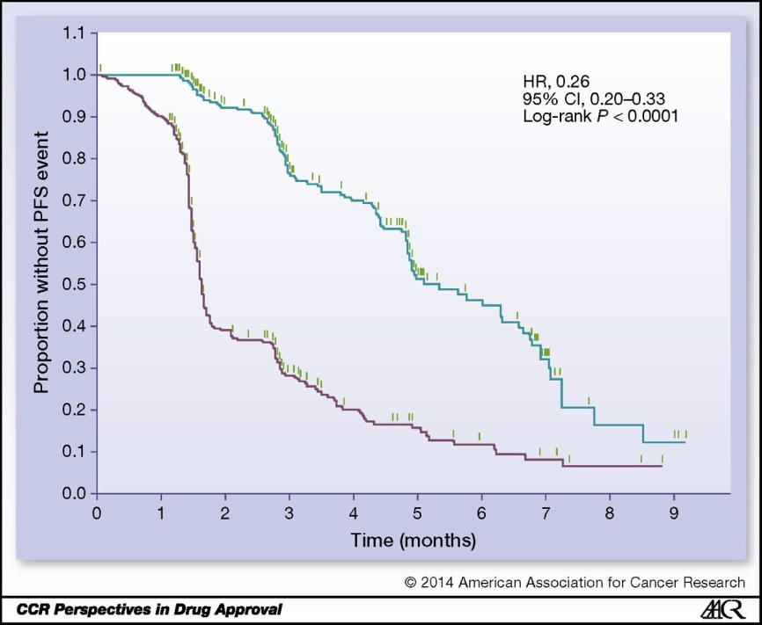
Efficacy
Overall Survival
Interim analysis of OS
HR: 0.37 (95% CI, 0.26–0.55; P < 0.001)
Updated OS analysis before approval
HR: 0.44 (95% CI, 0.33–0.59; P < 0.0001).
median OS
not been reached (NR) in the vemurafenib arm (95% CI, 9.6–NR)
7.9 months in the dacarbazine arm (95% CI, 7.3–9.6)
investigator-assessed PFS
HR was 0.26 (95% CI, 0.20–0.33; P < 0.0001).

Slide 37
Efficacy
Confirmed, investigator-assessed best ORR rate
Vemurafenib: 48.4% (95% CI, 41.6%–55.2%) in the arm compared with
Dacarbazine: 5.5% (95% CI, 2.8%–9.3%)
Responses
Vemurafenib:
2 complete responses (0.9%)
104 partial responses (47.4%)
Dacarbazine:
12 partial responses (5.5%)

Slide 38
BRIM3: Vemurafenib Front-Line Trial – Phase III Study Design
Screening
BRAF^{V600E} mutation
Stratification:
Stage
ECOG PS (0 vs 1)
LDH (elevated vs normal)
Geographic region
Vemurafenib
960 mg PO bid
(n = 337)
Randomization
n = 675
Dacarbazine
1000 mg/m² IV q3wk
(n = 338)
Co-primary endpoints were OS and PFS

Slide 39
Copyright © 2013 Massachusetts Medical Society. Reprinted with permission from Massachusetts Medical Society
Chapman PB et al. Proc ASCO 2012;Abstract 8502.

Slide 40
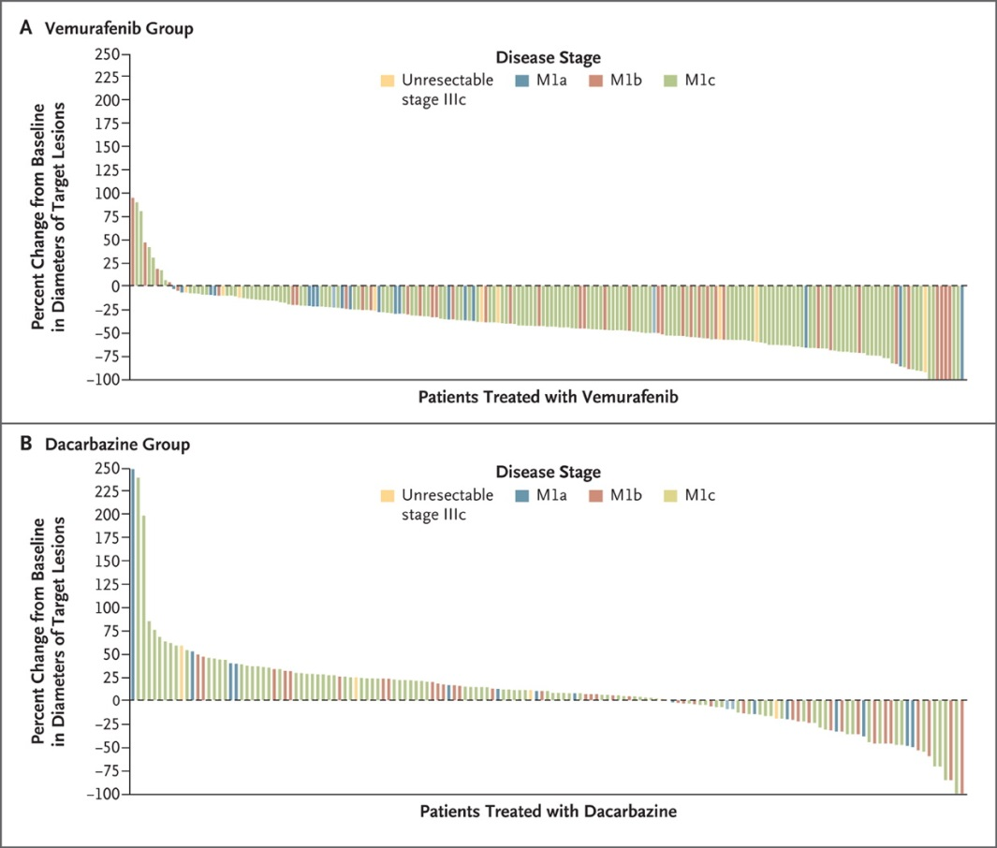
BRIM3: Best Tumor Response by Individual Patient
Vemurafenib
48.4% confirmed objective response (ASCO 2011)
57.0% confirmed objective response (ASCO 2012)
Dacarbazine
5% confirmed objective response (NEJM 2011)
8.6% confirmed objective response (ASCO 2012)
Chapman PB et al, Improved Survival with Vemurafenib in Melanoma with BRAF V600E Mutation, NEJM, 2011

Slide 41
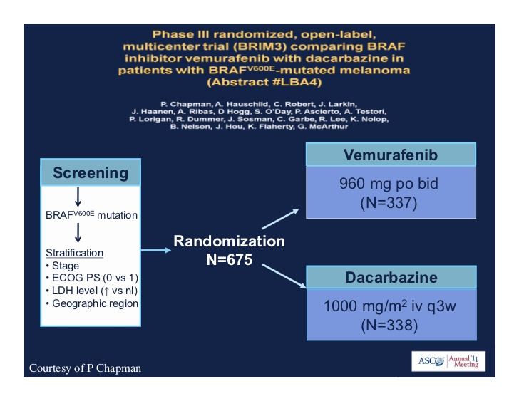
BRIM3 - Phase III

Slide 42
On August 17, 2011, the U.S. Food and Drug Administration (FDA) approved vemurafenib tablets (Zelboraf, Hoffmann-LaRoche Inc.) for the treatment of patients with unresectable or metastatic melanoma with the BRAF(V600E) mutation as detected by an FDA-approved test. The cobas 4800 BRAF V600 Mutation Test (Roche Molecular Systems, Inc.) was approved concurrently. An international, multicenter, randomized, open-label trial in 675 previously untreated patients with BRAF(V600E) mutation-positive unresectable or metastatic melanoma allocated 337 patients to receive vemurafenib, 960 mg orally twice daily, and 338 patients to receive dacarbazine, 1,000 mg/m(2) intravenously every 3 weeks. Overall survival was significantly improved in patients receiving vemurafenib [HR, 0.44; 95% confidence interval (CI), 0.33-0.59; P < 0.0001]. Progression-free survival was also significantly improved in patients receiving vemurafenib (HR, 0.26; 95% CI, 0.20-0.33; P < 0.0001). Overall response rates were 48.4% and 5.5% in the vemurafenib and dacarbazine arms, respectively. The most common adverse reactions (≥30%) in patients treated with vemurafenib were arthralgia, rash, alopecia, fatigue, photosensitivity reaction, and nausea. Cutaneous squamous cell carcinomas or keratoacanthomas were detected in approximately 24% of patients treated with vemurafenib. Other adverse reactions included hypersensitivity, Stevens-Johnson syndrome, toxic epidermal necrolysis, uveitis, QT prolongation, and liver enzyme laboratory abnormalities.

Slide 43
Discussions
Controversy over ethical aspects of employing a comparator arm (ex) chemoTX), widely acknowledged as suboptimal
ex) vemurafenib phase III trial in melanoma

Slide 44
BCS

Slide 45
Safety
The primary safety population included 336 patients in the BRIM-3 trial who received at least one dose of vemurafenib and 287 patients who received at least one dose of dacarbazine. Dose reductions were reported in 33% and 15% of patients receiving vemurafenib and dacarbazine, respectively. Dose delays were reported in 44% of patients receiving vemurafenib and 2% of patients receiving dacarbazine. Treatment discontinuations due to adverse drug reactions occurred in 7% of patients receiving vemurafenib and 4% of patients receiving dacarbazine. The most common adverse reactions leading to treatment discontinuation on the vemurafenib arm were arthralgia, dysphagia, and pneumonia.

Slide 46
Safety
As shown in Table 2, the most common (≥10%) grade 1–4 adverse reactions in patients receiving vemurafenib were nausea, diarrhea, vomiting, constipation, fatigue, pyrexia, peripheral edema, asthenia, increased lactate dehydrogenase (LDH), increased alkaline phosphatase, increased alanine aminotransferase (ALT), increased aspartate aminotransferase (AST), increased γ-glutamyl transpeptidase (GGT), increased bilirubin, increased creatinine, decreased appetite, arthralgia, pain in extremities, myalgia, skin papilloma, cuSCC, headache, dysgeusia, rash, alopecia, pruritus, erythema, photosensitivity reaction, hyperkeratosis, and dry skin. The most common (≥5%) grade 3–4 adverse reactions in patients receiving vemurafenib were cuSCC, increased GGT, and rash. Other notable toxicities included uveitis, blurred vision, iritis, and photophobia.

Slide 47
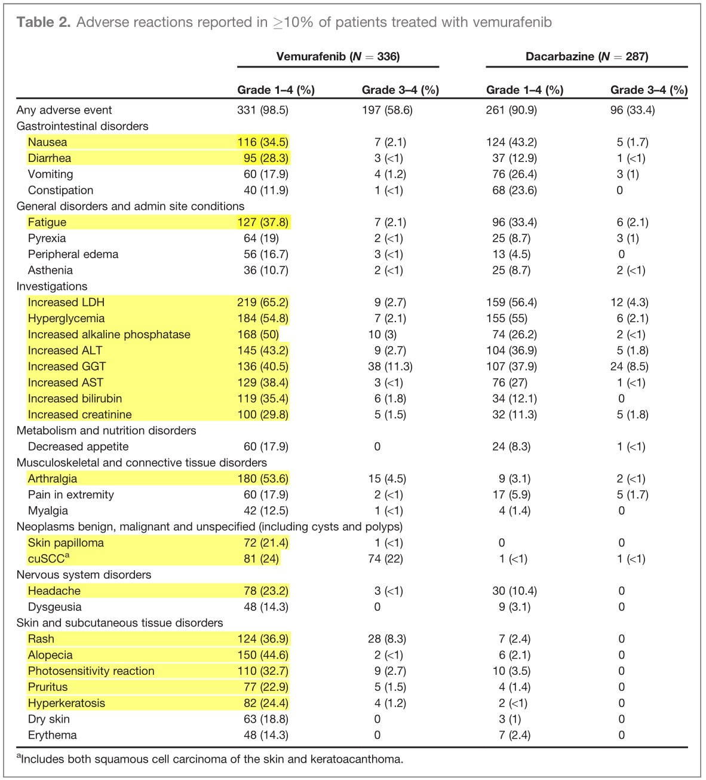

Slide 48
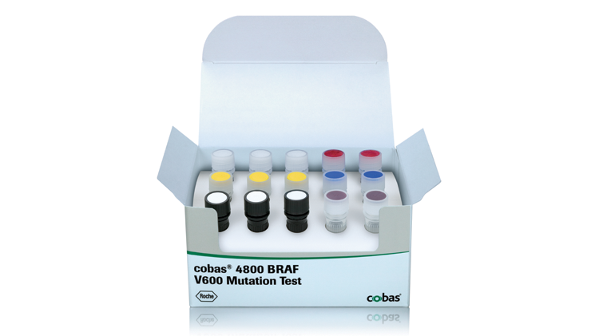
Companion Diagnostic for Vemurafenib
In vitro diagnostic: The cobas 4800 BRAF V600 Mutation Test
real-time PCR-based in vitro diagnostic
DNA from formalin-fixed, paraffin-embedded human melanoma tissue
It is intended for the selection of patients with BRAF^{V600E}-mutated melanoma for treatment with vemurafenib. The cobas and bidirectional Sanger sequencing results were compared in 449 evaluable cases (16). By the cobas test, there were 216 “mutation detected” cases. However, 35 of these were not V600E mutations by sequencing: 8 were wild-type, 25 were V600K, 1 was V600E2, and 1 was V600D. Six specimens were identified as “mutation not detected” by cobas but were V600E by sequencing. The positive percent agreement was 97.3%, the negative percent agreement was 84.6%, and the overall percent agreement was 90.9%. Seven of 16 (44%) patients with tumors positive for the V600E mutation by the cobas test but V600K by sequencing received vemurafenib and had a confirmed response, a response rate similar to that seen in the V600E population. The applicant agreed to a postmarketing commitment to develop an Investigational Use Only Companion Diagnostic (IUO CoDx) that reliably detects the BRAF^{V600K} mutation in tumors of patients with unresectable or metastatic melanoma and to conduct an open-label, single-arm trial in a population identified by this test with ORR and duration of response as the primary endpoints.
Notes:
https://molecular.roche.com/assays/cobas-4800-braf-v600-mutation-test/
A companion diagnostic for vemurafenib
The cobas® 4800 BRAF V600 Mutation Test detects the BRAF V600E mutation in formalin-fixed, paraffin-embedded (FFPET) human melanoma tissue. It is designed to help select patients for treatment with vemurafenib, an oral medicine designed to treat patients whose melanoma tumors harbor a mutated form of the BRAF gene.
Features and Benefits
The cobas® BRAF Mutation Test was used in pivotal clinical trials for vemurafenib, to select patients whose tumors harbor the V600E mutation in the BRAF gene.
In pre-clinical and clinical investigations, the cobas® BRAF Mutation Test had 97.3% positive agreement in detecting the BRAF V600E (1799 T>A) mutation, which represents >~85% of all BRAF mutations reported in the COSMIC database.
The cobas® BRAF Mutation Test is more sensitive in the detection of V600E mutations than Sanger sequencing.*
In formalin-fixed, paraffin-embedded tissue (FFPET), the cobas® BRAF Mutation Test can detect V600E mutations at >5% mutation level.*
The test may also detect other V600 mutations such as V600D and V600K.*
The cobas® BRAF Mutation Test has a low failure rate and is highly reproducible across operators, reagent lots and testing days.*
The cobas® BRAF Mutation Test can be performed in <8 hours from receipt of specimen.
Liquid, ready-to-use reagents are provided in the test kit to increase laboratory efficiency.
The test kits have >12 months shelf life from date of manufacture and upon opening each reagent maintains open-vial stability for up to 90 days.

Slide 49
Discussion
Until 2011, there were
no approved agents that had demonstrated a survival benefit in advanced malignant melanoma. Vemurafenib represents an important new treatment option for patients with BRAFV600E mutation–positive unresectable or metastatic melanoma and is the first personalized therapy for melanoma in which patients are selected using an analytically and clinically validated test. The new drug application was approved less than 4 months after submission.

Slide 50
Except for 5 patients in the dose-escalation portion of the phase I trial, vemurafenib had not been studied in patients whose melanomas were negative by the cobas test for the BRAFV600E mutation. No responses were seen and vemurafenib was not recommended for use in patients with wild-type (wt)BRAF or other BRAF mutations. In addition, there are data from xenograft models that RAF inhibitors can activate the RAF–MEK–ERK pathway in wtBRAF tumors and enhance growth (17).

Slide 51
Discussion
This application provides an example of the need for sponsors and the FDA to communicate and respond rapidly to important new information. With publication of the unprecedented results from the phase I trial, followed shortly thereafter by preliminary confirmation of activity of vemurafenib in the phase II trial, it became clear that the assumptions used to design the BRIM-3 trial were overly conservative. The FDA and the sponsor worked together quickly to amend the rapidly accruing BRIM-3 trial and to open an expanded access program.

Slide 52
감사합니다.
Thank you for your attention.

Slide 53
References
FDA, CDER, 202429Orig1s000
Medical Reviews https://www.accessdata.fda.gov/drugsatfda_docs/nda/2011/202429Orig1s000MedR.pdf
Approval Package 202429Orig1s000 https://www.accessdata.fda.gov/drugsatfda_docs/nda/2011/202429Orig1s000Approv.pdf
Clinical Pharmacology https://www.accessdata.fda.gov/drugsatfda_docs/nda/2011/202429Orig1s000ClinPharmR.pdf
Pharmacology https://www.accessdata.fda.gov/drugsatfda_docs/nda/2011/202429Orig1s000PharmR.pdf

Slide 54
References
https://www.cancer.gov/about-cancer/treatment/drugs/fda-vemurafenib
FDA Approval for Vemurafenib
Brand name: Zelboraf
Approved to treat late-stage or unresectable melanoma.
Full prescribing information is available, including clinical trial information, safety, dosing, drug-drug interactions and contraindications.
On August 17, 2011, the Food and Drug Administration (FDA) approved vemurafenib tablets (ZELBORAF, made by Hoffmann-La Roche Inc.) for the treatment of patients with unresectable or metastatic melanoma with the BRAFV600E mutation as detected by an FDA-approved test.
The approval was based primarily on an international randomized open-label trial in patients with previously untreated metastatic or unresectable melanoma with the BRAFV600E mutation as detected by the cobas 4800 BRAF V600 Mutation Test (made by Roche Molecular Systems, Inc.). This companion diagnostic test was approved by the FDA concurrently with vemurafenib’s approval.
The trial enrolled 675 patients; 337 patients were randomly assigned to vemurafenib, 960 mg orally twice daily, and 338 were randomly assigned to dacarbazine, 1000 mg/m2 intravenously, every three weeks. Treatment continued until disease progression, unacceptable toxicity, and/or consent withdrawal. All patients had an ECOG performance status of 0 or 1, and 95 percent of patients had metastatic disease. The major efficacy outcome measures of the trial were overall survival (OS) and investigator-assessed progression-free survival (PFS). Other outcome measures included confirmed investigator-assessed best overall response rate.
The median follow-up at the time of the overall survival analysis was 6.2 months for patients treated with vemurafenib and 4.5 months for patients treated with dacarbazine. Overall survival was significantly improved in patients receiving vemurafenib compared with those receiving dacarbazine (HR=0.44; 95 percent CI: 0.33, 0.59; p< 0.0001, log-rank test). The median survival of patients receiving vemurafenib had not been reached (95 percent CI: 9.6 months, not reached) and was 7.9 months (95 percent CI: 7.3, 9.6) for those receiving dacarbazine.
Progression-free survival (PFS) was also significantly improved in patients receiving vemurafenib (HR=0.26; 95 percent CI: 0.20, 0.33; p<0.0001, log-rank test). The median PFS was 5.3 months (95 percent CI: 4.9, 6.6) for patients receiving vemurafenib and 1.6 months for patients receiving dacarbazine (95 percent CI: 1.6, 1.7). Overall response rate (complete plus partial response rates) was 48.4 percent for patients receiving vemurafenib (95 percent CI: 41.6 percent, 55.2 percent) and 5.5 percent (95 percent CI: 2.8 percent, 9.3 percent) for patients receiving dacarbazine.
Vemurafenib was also evaluated in a single-arm multicenter trial that enrolled 132 patients with BRAFV600E mutation-positive metastatic melanoma who had received at least one prior systemic therapy. An independent review of treatment responses demonstrated a confirmed best overall response rate of 52 percent (95 percent CI: 43 percent, 61 percent), with a median response duration of 6.5 months (95 percent CI: 5.6, not reached).
The most common adverse reactions (at least 30 percent) in patients treated with vemurafenib were arthralgia, rash, alopecia, fatigue, photosensitivity reaction, and nausea. Cutaneous squamous cell carcinomas (cuSCC), including squamous cell carcinomas of the skin and keratoacanthomas, were detected in approximately 24 percent of patients treated with vemurafenib. CuSCCs were managed with excision in clinical trials, and patients were able to continue treatment without dose adjustment. Other adverse and sometimes severe reactions reported in patients treated with vemurafenib included hypersensitivity, Stevens-Johnson syndrome, toxic epidermal necrolysis, uveitis, QT prolongation, and liver enzyme laboratory abnormalities.
The recommended dose of vemurafenib is 960 mg, orally twice daily administered approximately 12 hours apart, with or without a meal.
Confirmation of BRAFV600E mutation-positive melanoma using an FDA-approved test is required before treatment with vemurafenib. Vemurafenib is not recommended for use in patients with wild-type BRAF melanoma. The approval also contains a Medication Guide to inform health care professionals and patients of vemurafenib’s potential risks.

Slide 55
Label (PDF) Letter (PDF) Review Summary Review (PDF)

Slide 56
Approval Label (PDF) Approval Letter (PDF) Approval Review Approval Summary Review (PDF)

